Slide 1



Flood Prediction Model
Developed by: Harsh Yadav Student ID: STU6836bb22f16921748417314
Internship ID: INTERNSHIP_17522267216870dba1e54a10023

Slide 2

Learning Objectives
1. Understand Flood Prediction Concepts
Learn how environmental factors like rainfall, river level, and soil moisture contribute to floods.
Recognize the importance of early prediction in disaster management and community safety.
2. Data Handling Skills
Gain experience in importing, cleaning, and preprocessing datasets using pandas and numpy.
Learn to identify and manage missing values, outliers, and imbalanced data.
3. Exploratory Data Analysis (EDA)
Perform data visualization using matplotlib and seaborn to uncover trends and patterns.
Use statistical summaries (.info(), .describe(), .isnull().sum()) to understand dataset quality.
4. Machine Learning Model Development
Train and test a Decision Tree Classifier to predict flood occurrence.
Understand the workflow of splitting data into training and testing sets.
Learn how to measure performance using accuracy score.
5. Practical Application
Build an interactive model based deployment that accepts user inputs (rainfall, river level, soil moisture) and predicts floods in real-time.
GOAL
Source :
www.freepik.com/

Slide 3
Tools and Technology used
Programming Language → Python (3.9.13) Tools: Jupyter Notebook - VS Code GitHub CSV Dataset [Kaggle] Libraries & Frameworks:
pandas → For loading, cleaning, and preprocessing data.
warnings → For ignoring sleepy / ignorable user warnings. matplotlib → For basic data visualization.
seaborn → For advanced and stylish plots (count plots, box plots, heatmaps).
scikit-learn (sklearn) →
- train_test_split → Splitting dataset into training and testing sets.
- DecisionTreeClassifier → Training the ML model.
- accuracy_score → Evaluating model performance. streamlit → UI based deployment of model

Slide 4
Methodology
1. Problem Identification
Floods are a recurring natural disaster in India, often causing loss of life, property, and agricultural damage.
The goal of this project is to build a machine learning-based model that can predict the possibility of a flood based on key environmental factors.
2. Data Collection
A dataset was created containing rainfall, river water level, and soil moisture values from Kaggle.
3. Data Preprocessing
The dataset was explored using .info(), .describe(), and .isnull().sum() to check for missing and inconsistent values.
Missing values were handled by cleaning or removing rows with incomplete data.
The dataset was then normalized and prepared for model training.
4. Exploratory Data Analysis (EDA)
Visualizations were created using Seaborn and Matplotlib to understand relationships between variables.
Count plots and box plots were used to compare rainfall, river levels, and soil moisture distributions for flood vs. no flood conditions.
5. Model Development
The features (Rainfall, River_Level, Soil_Moisture) were selected as independent variables, and Flood (Yes/No) was chosen as the target variable.
The dataset was split into training (70%) and testing (30%) sets using train_test_split.
A Decision Tree Classifier from scikit-learn was used to build the predictive model.
6. Model Evaluation
The model was evaluated using accuracy score on the testing set.
7. User Interaction
The model was extended to take user inputs for rainfall, river level, and soil moisture.
Predictions are displayed interactively, showing whether a flood is likely to occur or not in the deployed state.

Slide 5
Problem Statement:
Floods are among the most devastating natural disasters in India, causing loss of lives, destruction of property, and significant economic damage every year. Accurate and early flood prediction is critical to help authorities and communities take preventive measures and minimize disaster impacts.
Github Link: https://github.com/Harsh2005adgitm/Flood-Responsive-Model-EDUNET---AICTE-GREEN-SKILL-AI-INTERNSHIP-

Slide 6
Solution:
To address the problem of unpredictable floods and their devastating impact, this project implements a Flood Prediction Model using Machine Learning techniques.
The proposed solution involves the following steps:
1. Data Collection & Preprocessing
A dataset was prepared containing important features such as rainfall, river water levels, and soil moisture.
The dataset was cleaned by handling missing values and removing inconsistencies.
2. Exploratory Data Analysis (EDA)
Performed statistical analysis (.info(), .describe(), .isnull().sum()) to understand the dataset.
Visualized the relationships between features and flood occurrence using Seaborn plots (count plots, box plots, etc.).
3. Model Development
A Decision Tree Classifier was implemented using scikit-learn to classify whether a flood would occur (Yes = 1, No = 0).
The dataset was divided into training and testing sets to evaluate model performance.
4. User Interaction
The model accepts user input values (rainfall, river level, and soil moisture) and predicts the likelihood of a flood.
This makes the system interactive and usable in real-world applications.
5. Results & Evaluation
The model achieved an accuracy of 68%, showing that machine learning can effectively predict flood risk with the given features.
Accuracy and performance metrics indicate the model’s reliability in supporting early warning systems.

Slide 7
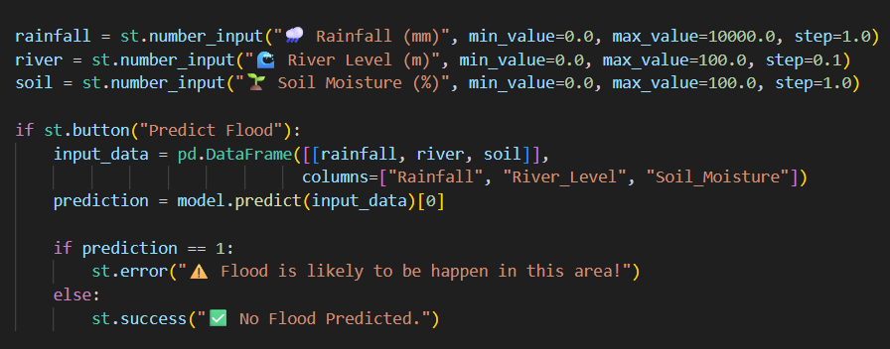
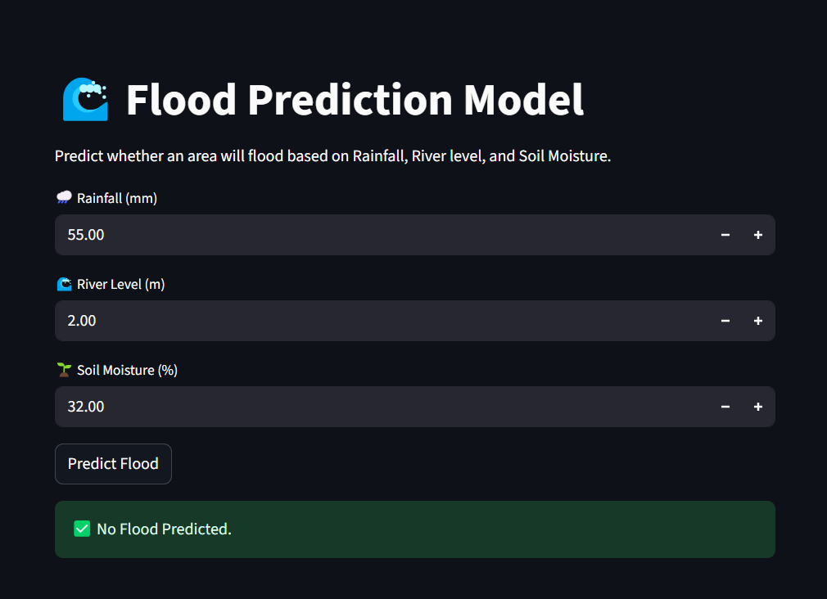
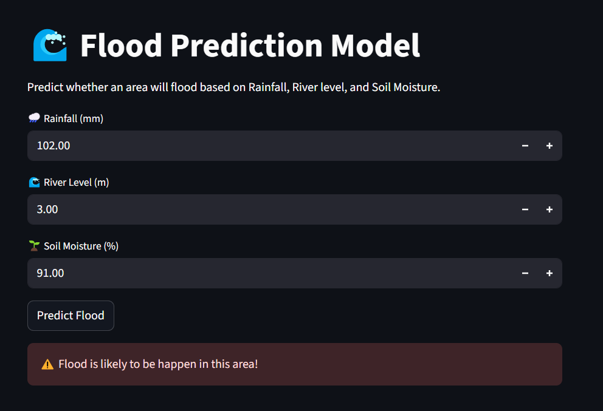
Screenshot of Output:
Takes input from the user
No Flood Prediction
Flood Prediction

Slide 8
Conclusion:
This project successfully demonstrates the use of Machine Learning in predicting floods based on key environmental factors such as rainfall, river water level, and soil moisture. By applying a Decision Tree Classifier, the model was able to achieve an accuracy of approximately 68%, showing promising results in identifying potential flood risks. Through data preprocessing, exploratory data analysis, and model evaluation, the project highlights how data-driven approaches can support disaster management systems. The model’s ability to accept user inputs and provide real-time predictions makes it practical and easy to implement in early warning frameworks. In conclusion, this project demonstrates that artificial intelligence can be a valuable tool in mitigating the impact of natural disasters. By predicting floods with reasonable accuracy, it can assist governments, farmers, and local communities in making informed decisions, ultimately contributing to safety, preparedness, and sustainable development.

